Slide 1



Live It Right
PRESENTATION
Presented by :
Arwa Seada Dina Elharedy
Joy Osama Yousef Elgendy
Ehab Abdel Gayed

Slide 2


Empowering Those with Dietary Restrictions.
Eat Well, Be Smart, Live IT Right

Slide 3






How it started !
- Because we believe health should be easy, personal, and within reach for everyone who wants to Live it Right

Slide 4






Target Audience

Slide 5
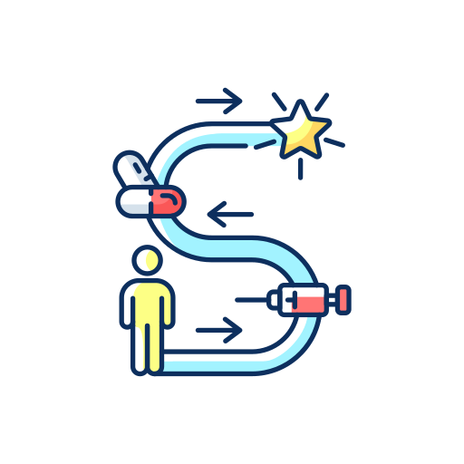

Why It Matters !
Diabetes
17%
Pre-Diabetes
10%
Lactose intolerance
68%
Health challenges
Gluten intolerance
1.5%

Slide 6










From Problem
To Possibility
Before
After

Slide 7




What Make Us Unique !
All-in-One Platform
Time & Stress Saving
Accessible & User-Friendly Design
Personalized & Educational Content

Slide 8












Methodology
Planning
Development
Research Phase
Design
Evaluation

Slide 9





from Hurdles to Highlights
Not a Substitute for Medical Advice
Limited Language & Accessibility Options
Internet Required for Certain Features
Depending on local host
Product`s price shown in USD

Slide 10

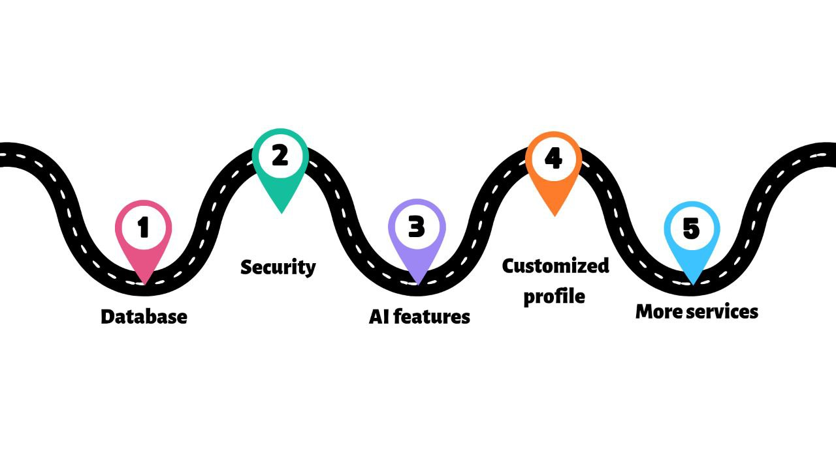
Future Enhancements

Slide 11


Our Mission
Supporting people with dietary sensitivities—like diabetes, gluten, and lactose intolerance—through smart tools and trusted information to make healthy living easier, more accessible, and personalized.
Our Vision
To be the go-to digital platform for health-conscious individuals, making well-being accessible, personalized, and part of daily life — guided by knowledge, care, and community.
'Together, we can make life better for those with dietary restrictions.'

Slide 12
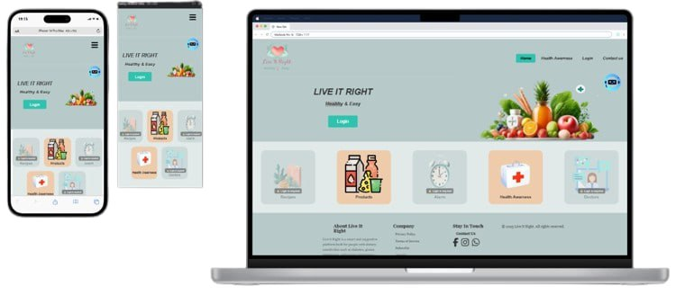
Features
User Experience and Design
You can visit us on :
https://arwaseada.github.io/Live_It_Right/Graduation%20project%202025/Home-page/index.html

Slide 13




Slide 14





THANK YOU

